Slide 1
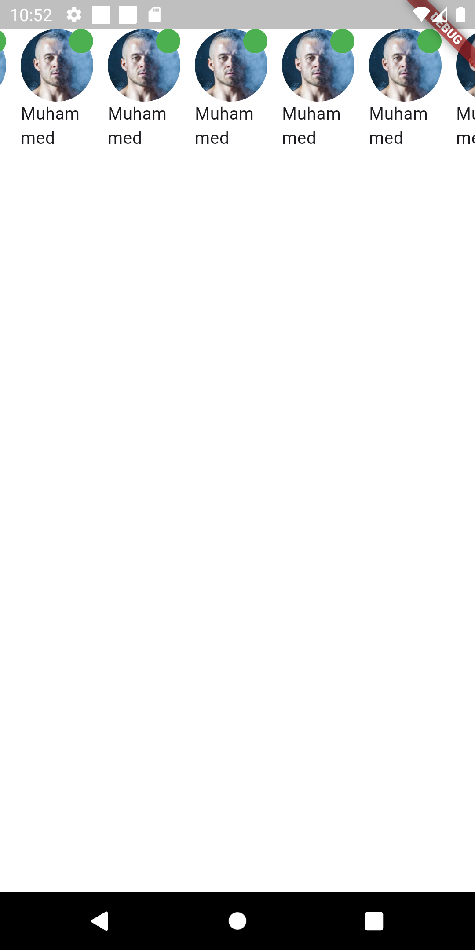
Task 1
Use what you learned to achieve this
Search for ListView.separated and see how to use it to add
Space between items
Use this image url
https://i.pravatar.cc/150?img=3
Search for how to make a circle image or how to give it
Border radius

Slide 2
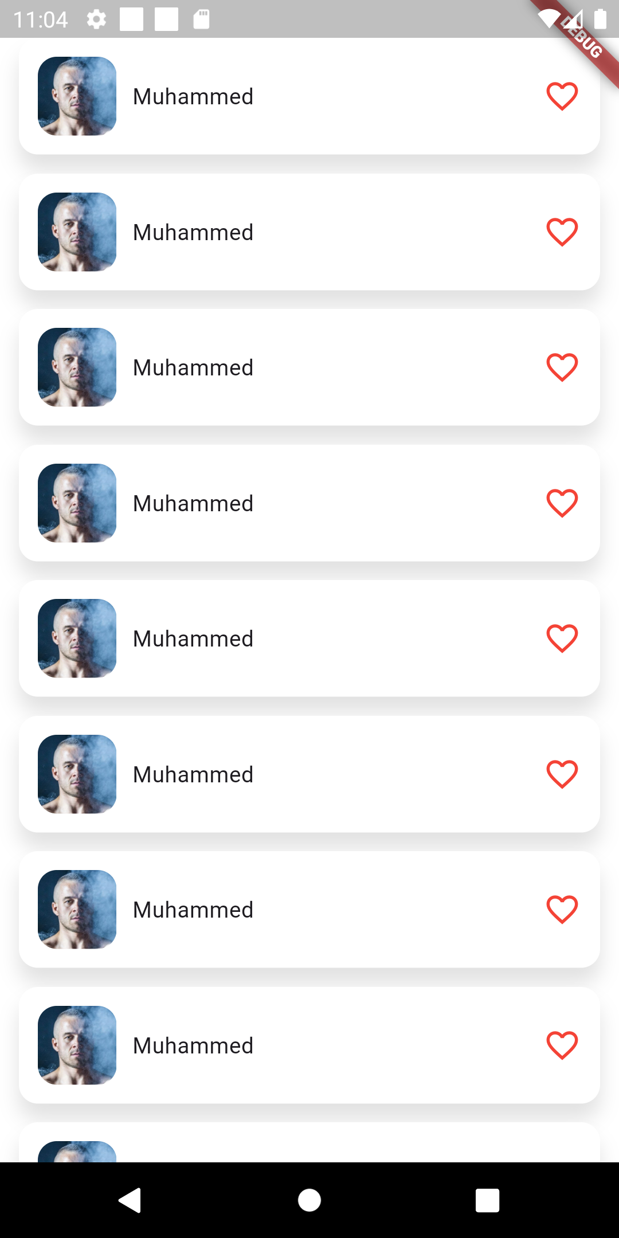
Task 2
Use what you learned to achieve this
The container has a padding of 12 and border radius of 12
Boxshadow values => x = 0, y = 10
Color : Colors.black.withAlpha(30)
Blur : 10
The image has a radius of 12 also
Search for how to add icons

Slide 3
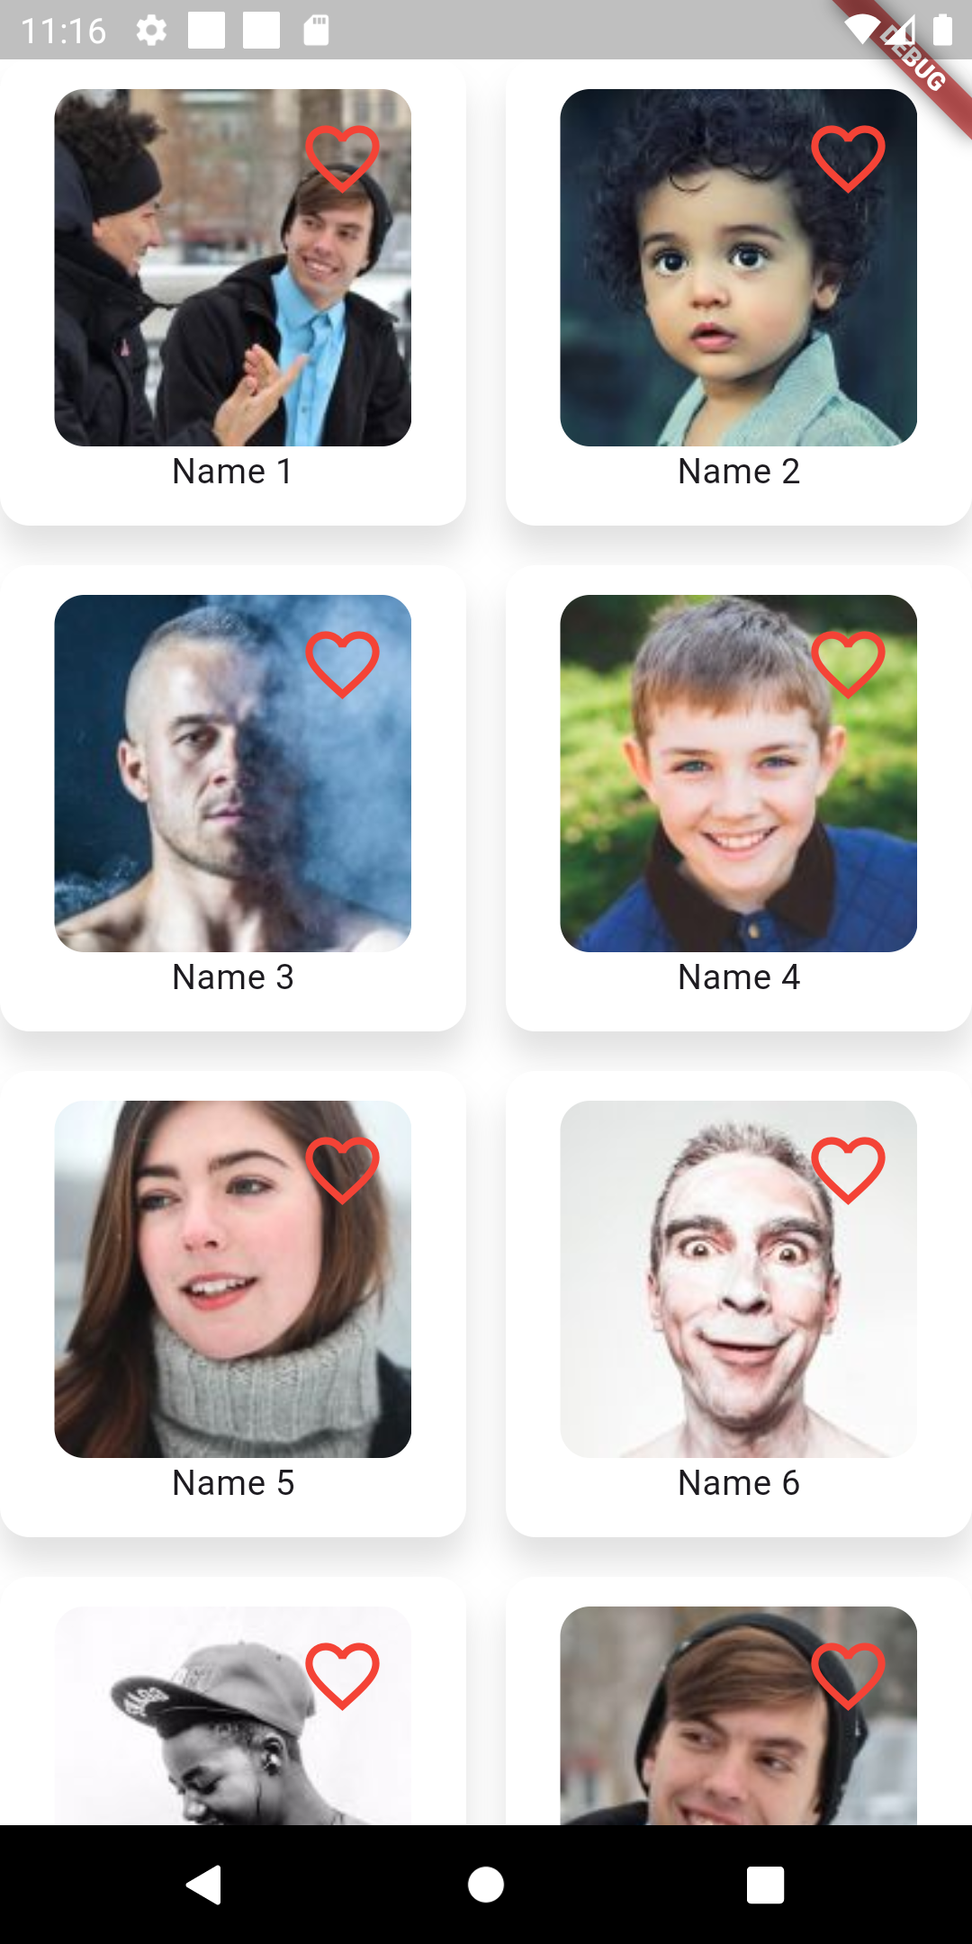
Task 3
Given the dummy friend model, use the static method
Inside the class to return the list of friends and display them
In a grid like so

Slide 4
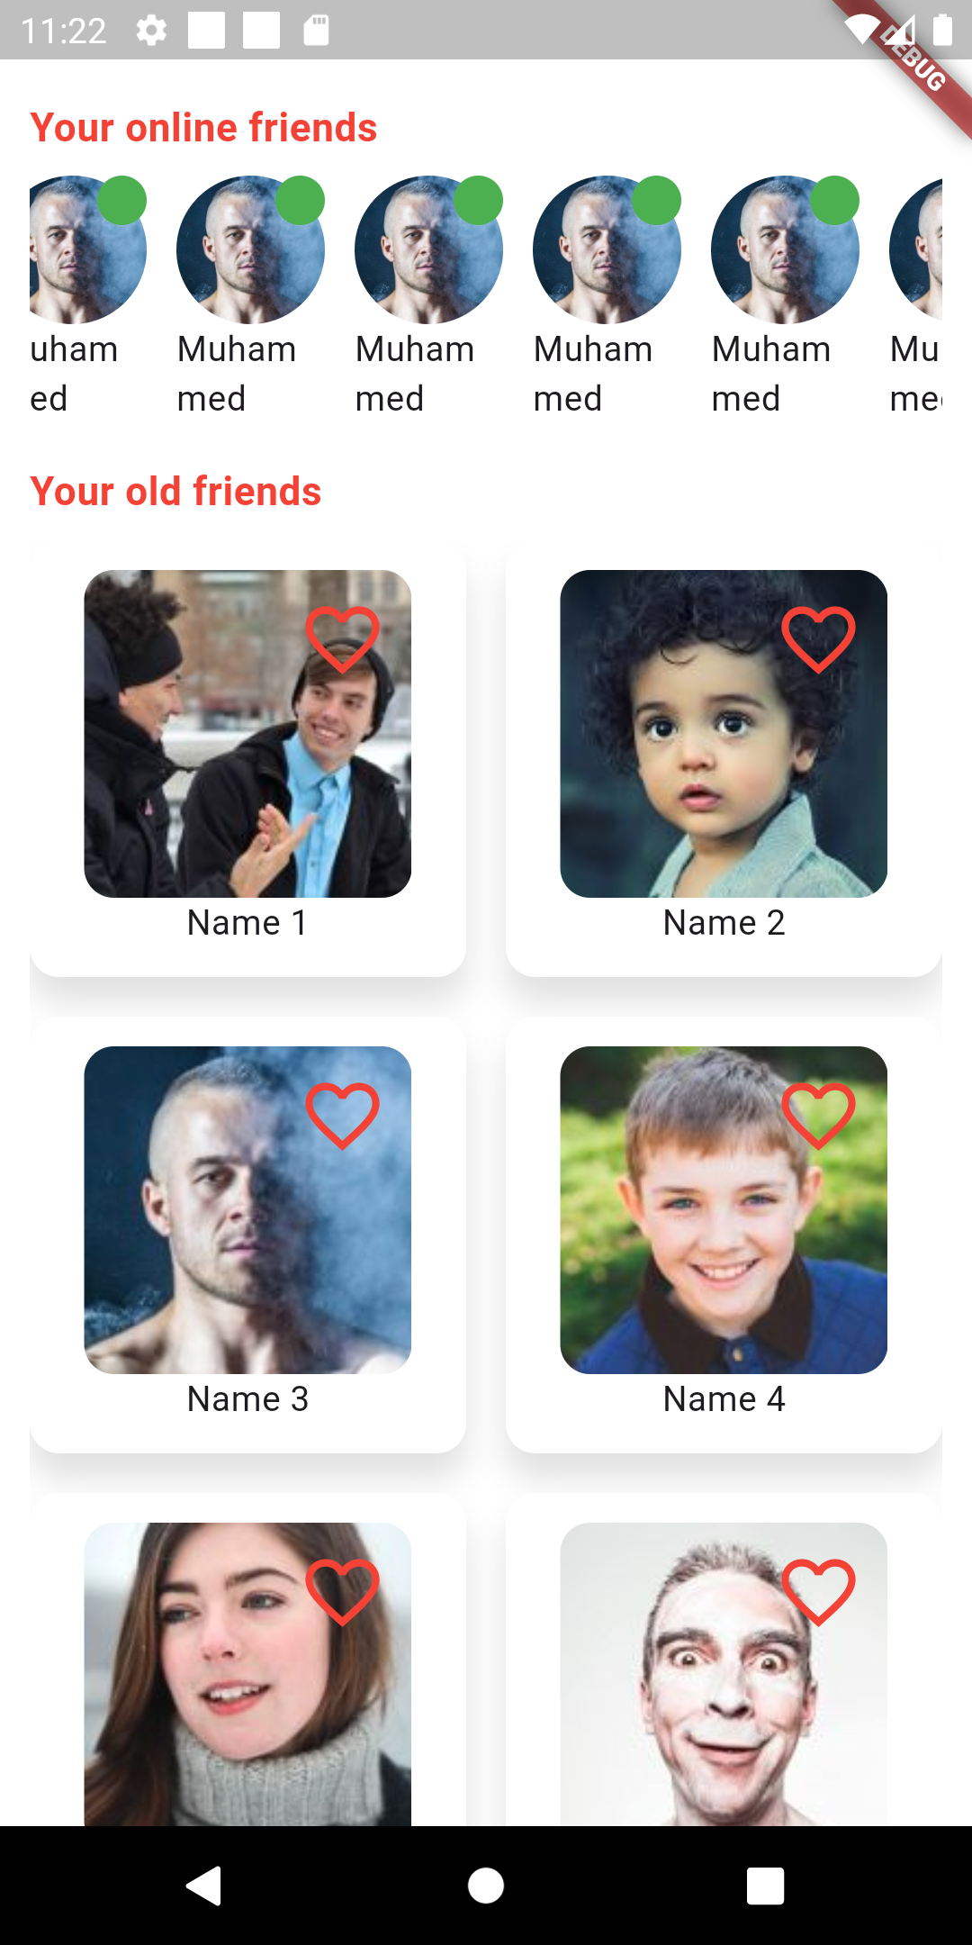
Task 4
Let’s put the first and the third task together to achieve
This look , both the red text are bold and have a size of 16

